Slide 1
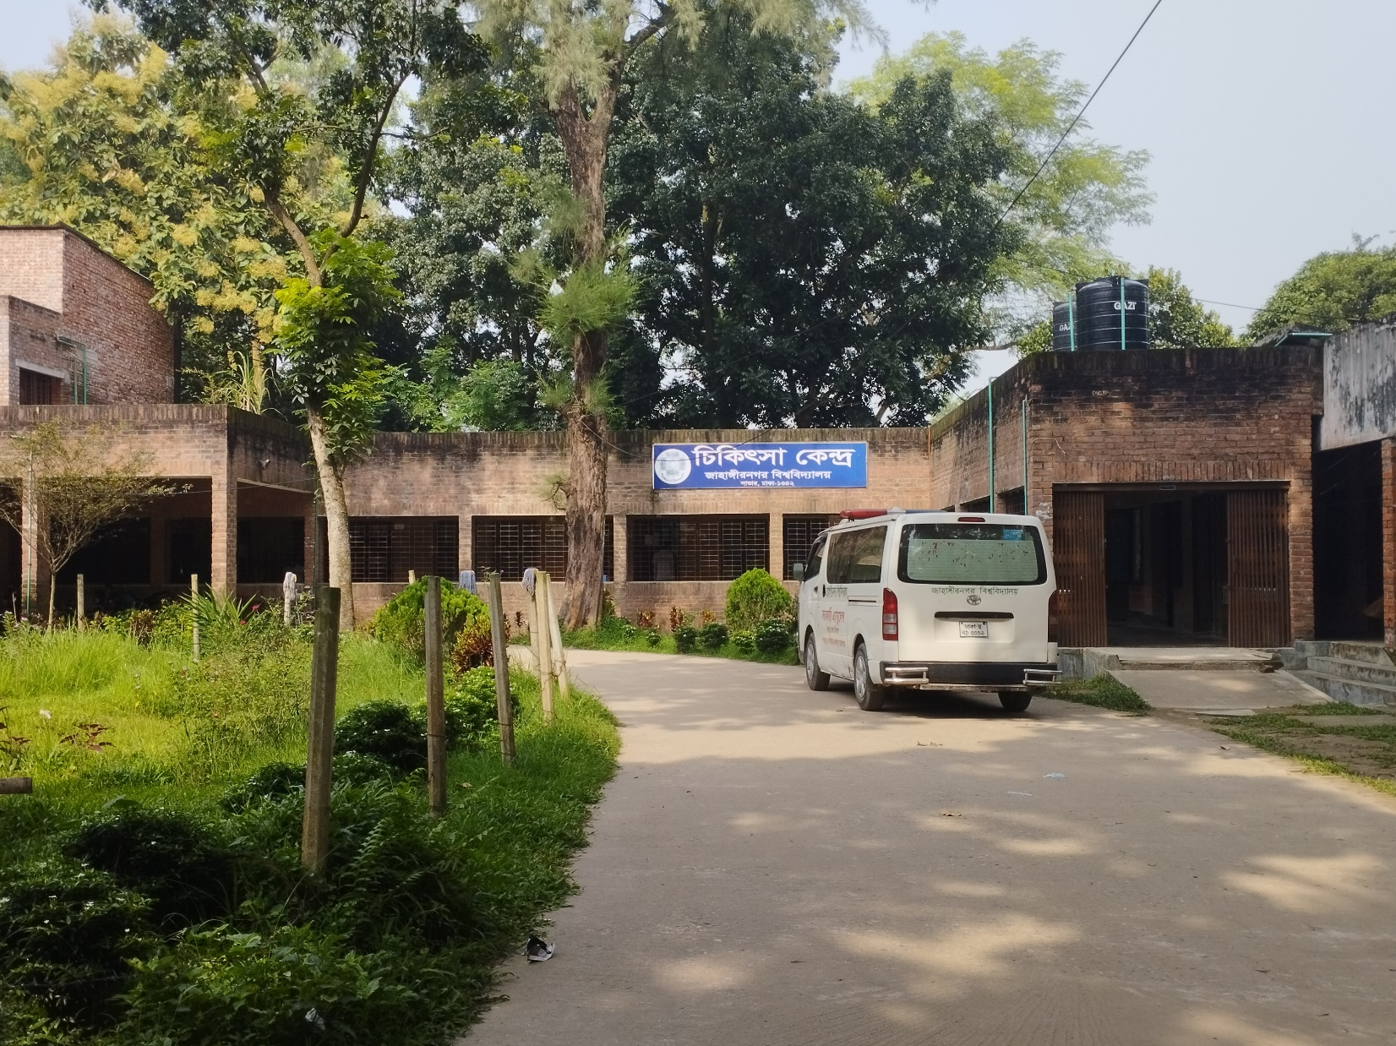
JAHANGIRNAGAR UNIVERSITY MEDICAL CENTER MANAGEMENT
SYSTEM
Prepared By
Subarna Saha-349
Fatima Binte Aziz-367
Md Soad Anam-385
Md Hasan Al Mamun-399
Shabrina Akter Shahana-2147
Notes:
Assalamualaikum, Good afternoon everyone. I am Hasan Al Mamun. I would like to extend a warm welcome to all of you today. Today I have the pleasure of introducing you to an exciting project: Jahangirnagar University Medical Center Management System. The reason we chose this project is that as students of Jahangirnagar University, whenever we face health issues we have to visit JU Medical Center. But unfortunately, the medical center does not have proper management facilities. Which is why the students fail to get standard treatment.
Before we dive into the details let’s start with a brief overview.

Slide 2
JU MEDICAL CENTER MANAGEMENT SYSTEM
The "Jahangirnagar University Medical Center Management System" is a Transformative Digital Solution aimed at modernizing the traditional healthcare practices at Jahangirnagar University. Currently, the medical center relies on: Manual Record-Keeping, Data Vulnerability, and Limited Storage Capacity.
Our vision is to elevate healthcare standards, promote a healthier campus community, and optimize medical services. Through this digital transformation, we aim to improve the overall quality of healthcare services provided at Jahangirnagar University Medical enter.
01
Notes:
The "Jahangirnagar University Medical Center Management System" is a Transformative Digital Solution aimed at modernizing the traditional healthcare practices at Jahangirnagar University. Currently, the medical center relies on: Manual Record-Keeping, Data Vulnerability, and Limited Storage Capacity.
Our vision is to elevate healthcare standards, promote a healthier campus community, and optimize medical services. Through this digital transformation, we aim to improve the overall quality of healthcare services provided at Jahangirnagar University Medical center.

Slide 3
the proposed system will provide
Patient Management
Streamline Patient Registration
Appointment Scheduling
Medical History Access
Doctor Collaboration
Facilitate Doctors in Updating Records
Prescribing Medications
Ordering Tests.
Medical Services
Offer Online Test Booking
Medicine Ordering
Ambulance Requests.
Data Security
Ensure Robust Data Protection through Authentication and Encryption.
Notifications
Automate Reminders for follow-up Appointments and Test Results.
Efficiency
Optimize operations by digitizing bed booking and appointment management.
02
Notes:
Our proposed system will provide a large number of facilities. I am presenting some of the facilities.
Patient Management Streamline Patient Registration
Appointment Scheduling Medical History Access
Doctor Collaboration Facilitate Doctors in Updating Records Prescribing Medications Ordering Tests.
Medical Services Offer Online Test Booking Medicine Ordering
Ambulance Requests.
Data Security
Ensure Robust Data Protection through Authentication and Encryption.
Notifications
Automate Reminders for follow-up Appointments and Test Results.
Efficiency
Optimize operations by digitizing bed booking and appointment management.

Slide 4
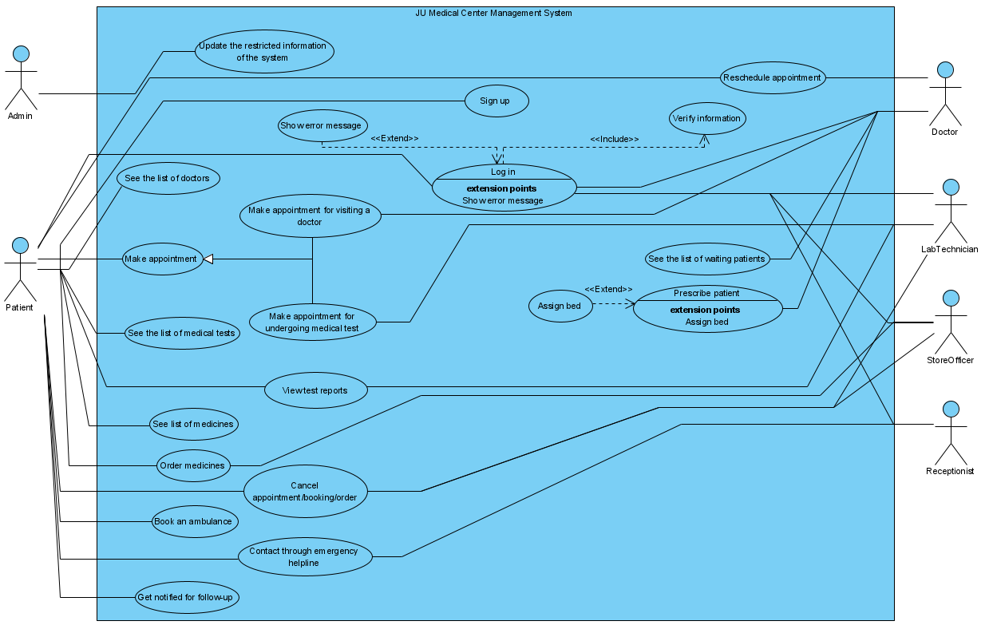
USE CASE DIAGRAM
03
Notes:
Now, let's take a closer look at the core functionalities of our "Jahangirnagar University Medical Center Management System" through this use case diagram. In this diagram, we have three primary actors: Admin, Patients, Doctors are three primary actor. Doctor is also a secondary actor in this diagram.
[Point to each actor on the diagram as you mention them.]
Let's walk through some of the key interactions represented here:
1. **Patient:** Our patients, represented by this actor, have several actions they can take. They can sign up and log in to the system, view the list of available doctors, and make appointments with their preferred physicians.
2. **Doctor:** The doctor actor signifies our medical practitioners. They can log in, view their patient appointments, and provide healthcare services, such as diagnosing patients and prescribing medicines.
3. **Lab Technician:** Lab technicians play a crucial role in our system. They can log in, view lab test appointments, and perform necessary tests for patients.
4. **Medicine Store Officer:** This actor handles medicine-related operations. They can log in, manage medicine orders, and ensure a smooth supply of medications to our patients.
Additionally, our system facilitates various interactions, such as booking an ambulance in case of emergencies, contacting the receptionist for assistance, and ordering medicines conveniently.
This use case diagram serves as a visual representation of the diverse functionalities within our system, illustrating how each actor interacts with the system to provide and receive healthcare services efficiently. As we move forward in our seminar, I'd like to inform you that my teammate, Fatima Binte Aziz, will be leading the presentation from this point onward.

Slide 5
USER STORY-1
As a Patient I want to make appointment for undergoing medical tests.
Confirmation:
• If Patient selects the "Place appointment" button from the list of medical tests, system will show extended information about the test.
• If the Patient is not okay with the immediate next available time, system will give the option to select any of the available date and time in future.
• If Patient selects the suitable appointment time, he clicks the "Confirm" button to confirm the appointment.
• If the appointment is confirmed, system sends the Patient a confirmation mail with the details of the appointment such as name of the medical test, prerequisites of the test and date and time of appointment etc.
• If the appointment is confirmed, the Lab-technician is also notified with an email about the appointment to whom the user has made an appointment.
04
Notes:
The second user story describes about making appointment for undergoing medical test. The patient places appointment according to his comfort. He has the flexibility to select suitable appointment. After confirming the appointment, the patient and the lab technician both will be notified via an email.

Slide 6
USER STORY-2
As a patient I want to view my medical test report.
Confirmation:
• If Patient selects the “View test reports" button from his dashboard, system will show the list of medical tests the Patient has undergone before and the status of the test reports for each medical test.
• If the status of the selected test report is "Ready", the Patient can download the test report in PDF format by clicking the "Download" button.
• If the patient selects some test reports which are ready and clicks on "Compare" button, system will compare the reports about show the results of the comparison.
05
Notes:
Assalamualaikum. I am Fatima Binte Aziz. My previous Teammate Hasan Al Mamun has given us the brief overview of our project JU Medical Center Management System and has described the use-case diagram. In this part of the presentation, I'll be focusing on two crucial aspects: the user stories we've identified and the extended use cases we've developed.
Let's start with the user stories. A user story is a concise, informal, and non-technical description of a software feature from the perspective of an end user. Our first user story describes the account creation within our system. If a user wants to create an account, he must submit a form filling all the information if he hasn’t registered already. If the username is invalid or taken already, the system will notify the user. The user should also have strong password. Thus an account is created.

Slide 7
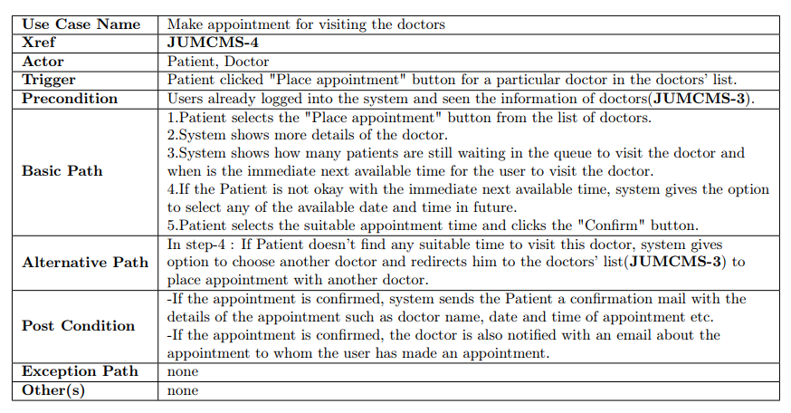
EXTENDED USE CASE-1
06
Notes:
Now we have our extended use case. The 1st use case is about making appointment for visiting a doctor. We have two actors here -the patient and the doctor. The patient triggers by clicking place appointment and to do so, the patient must be logged into the system. After the patient selects “place appointment” button, the system will show details of the doctor, and also of the other patients who are still in the queue. If the patient wants to switch to another available time, he has that freedom. Lastly, after patient has confirmed it both the doctor and the patient will get an email.

Slide 8
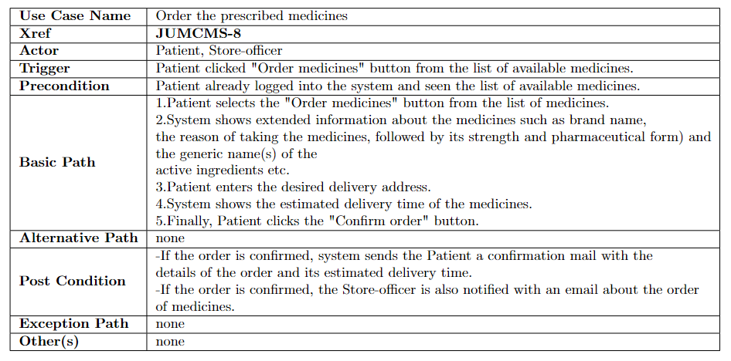
EXTENDED USE CASE-2
07
Notes:
Our second use case gives us idea about ordering the prescribed medicine. Here two actors are needed to complete this task- the patient and the store manager. After being logged into the system, the patient clicks “order medicine” and the system generates information about the medicine. After the patient has given the address where the medicine has to be shipped, the patient gets to see the estimated delivery time and both the patient and the store officer will get confirmation email about ordering.

Slide 9
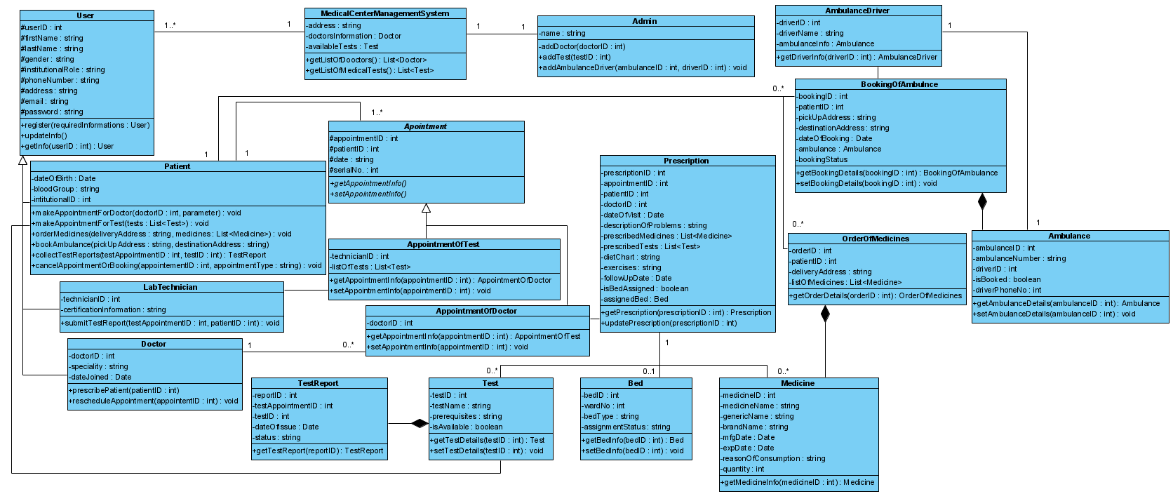
CLASS DIAGRAM
08
Notes:
Respected teachers and my fellow classmates,
Assalamualaikum and Good morning, I am Subarna Saha. I am feeling honoured to have the opportunity to present to you our project Jahangirnagar University Medical Center Management System. My teammates have previously presented different aspects of our project.
Now, I'll be showing you our system's class diagram and sequence diagrams. These diagrams are like maps that help us understand how different parts of our system work together.
Class diagram encapsulates the foundational structure and relationships within our project, providing a visual representation of how different components interact and collaborate to achieve our project's goals. At its core, a class diagram serves as a blueprint for the architecture of our software, mapping out the classes, attributes, methods, and associations that form the building blocks of our solution. It provides us with a comprehensive overview of the entities and their interactions, aiding us in crafting a robust, scalable, and maintainable system.
As we delve into the diagram, you'll notice that each class represents a distinct entity or concept within our project such as patient, doctor, admin, medicine, test etc. The attributes within these classes define the properties and characteristics of these entities, while the methods encapsulate the behaviours they can perform. These classes are connected through relationships, illustrating how they collaborate and communicate to fulfil our project's functionality.
Our project's success hinges on the clear understanding of some key elements:
One of them is Abstraction and Modularity: Among different classes, Appointment class can be considered as an example of abstraction. showcases how we have abstracted complex entities and processes into manageable classes in this diagram. This is an abstract class which contains different attributes and abstract methods. These methods are abstract because the implementation if them are not present here. This promotes modularity and allows us to work on individual components.
Encapsulation and Data Hiding is another feature which is quite important for the security of a project. In the diagram, there is Prescription class which has attributes like prescription id. All of their access modifier is set as private so that these attributes can only be accessed using the public functions of this class. Through the use of public, private and protected access modifiers, we ensured that data is encapsulated and accessed only through controlled methods.
On the other hand, the inheritance relationships depicted in the diagram illustrate how classes can inherit attributes and methods from parent class. Here the USER class has different attributes such as blah and methods blah which are inherited by the DOCTOR, PATIENT and LAB-TECHNICIANS class. In this way, all the attributes and methods of the USER class are inherited to the other classes. This approach promotes code reusability and flexibility.
In this diagram, The lines connecting classes represent associations and dependencies. Such as,
The Multiplicity of the association of different classes is also mentioned here. As a example,
In conclusion, this class diagram isn't just a static representation; it's a dynamic guide that will evolve as our project progresses.

Slide 10
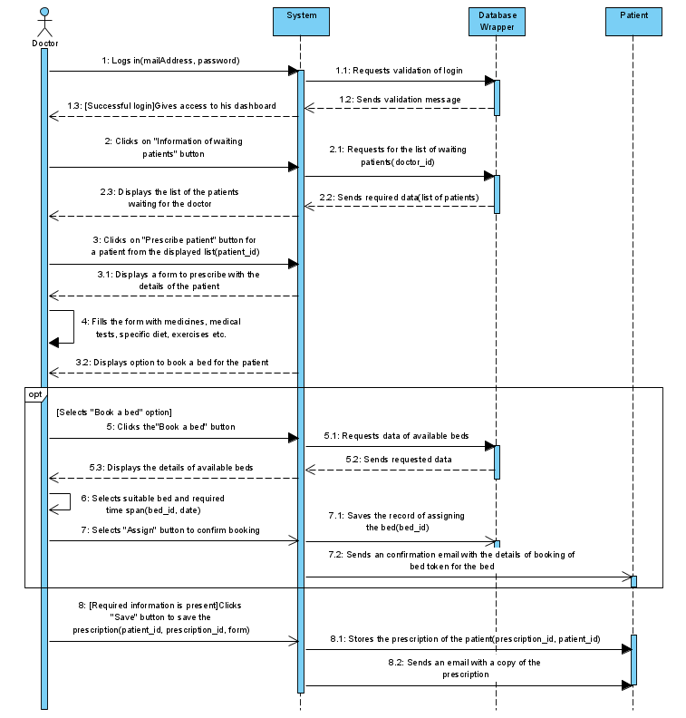
SEQUENCE DIAGRAM-1
09
Notes:
As we move forward, This is the sequence diagram of logging into the system.
A sequence diagram is a type of diagram used in software engineering and system design to visually represent the interactions and communication sequences between various objects, components, or actors within a system or a process. It belongs to the Unified Modeling Language (UML) and is particularly useful for depicting the dynamic behavior of a system over time.
In a sequence diagram, different entities are depicted as vertical lifelines, and the interactions between these entities are represented using arrows to show the sequence and flow of messages or method calls exchanged between them. The horizontal axis typically represents time, progressing from the top to the bottom.

Slide 11
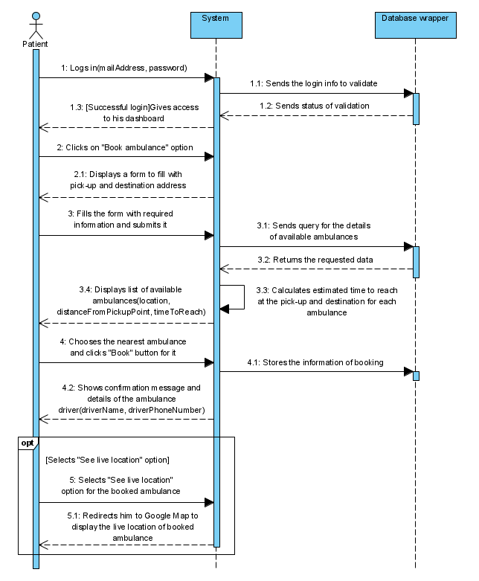
SEQUENCE DIAGRAM-2
10
Notes:
As we move forward, This is the sequence diagram of logging into the system.
A sequence diagram is a type of diagram used in software engineering and system design to visually represent the interactions and communication sequences between various objects, components, or actors within a system or a process. It belongs to the Unified Modeling Language (UML) and is particularly useful for depicting the dynamic behavior of a system over time.
In a sequence diagram, different entities are depicted as vertical lifelines, and the interactions between these entities are represented using arrows to show the sequence and flow of messages or method calls exchanged between them. The horizontal axis typically represents time, progressing from the top to the bottom.

Slide 12
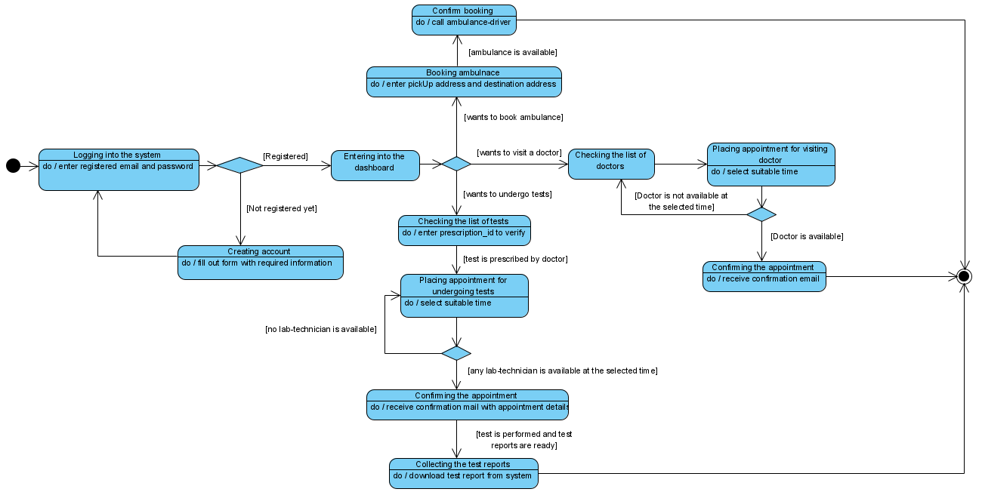
STATE CHART DIAGRAM
11
Notes:
Hello everyone, Assalamualaikum. I'm Shabrina, and I'll be presenting the State Chart Diagram of our system.State Chart Diagram is a graphical representation used to model the dynamic behaviour of a system. So, let's dive into the State Chart Diagram of a patient, to illustrate the different states and transitions that a patient can go through during their interaction with the medical center.So first of all, a patient creates an account then login to the system using valid credentials. Then the user redirected to his dashboard. This introduces the user with the features of the system.Such as:
#Booking Ambulance #Checking the list of Doctors #Checking the list of medical tests.To book an Ambulance the user enters the pickUp and destination address and if the ambulance is available, then system confirms the booking. Now the patient can call the driver of the ambulance. After successful booking an ambulance workflow terminates.The patient can view the doctors, pick a time for an appointment, and if his chosen doctor isn't available, the user can repeat the process. Once the user confirms an appointment, it will get an email, and then workflow terminates.Patients can also review the medical list similarly. Upon test verification, they can schedule medical tests at a suitable time. If a lab technician is available, the appointment gets confirmed, and a confirmation email is sent; otherwise, they can search for another available technician. Once the lab test is done, patients can download their report, concluding the process.This is how the state chart diagram of a patient of our system flows actually.Thank you everyone, that’s all from my part. Now my next teammate Soad anam will continue the rest of the part of our presentation.

Slide 13
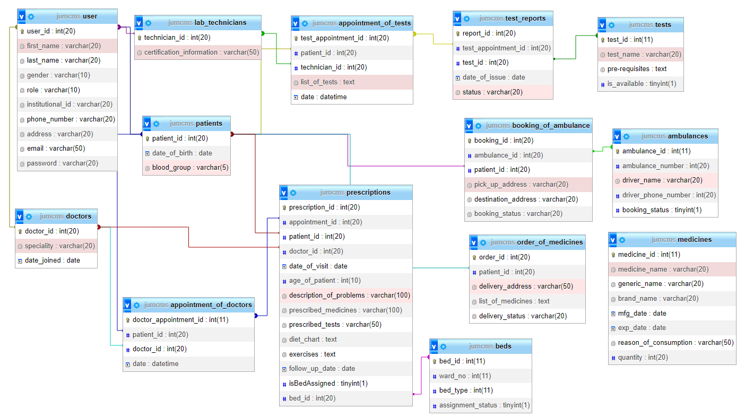
DATABASE SCHEMA
12

Slide 14
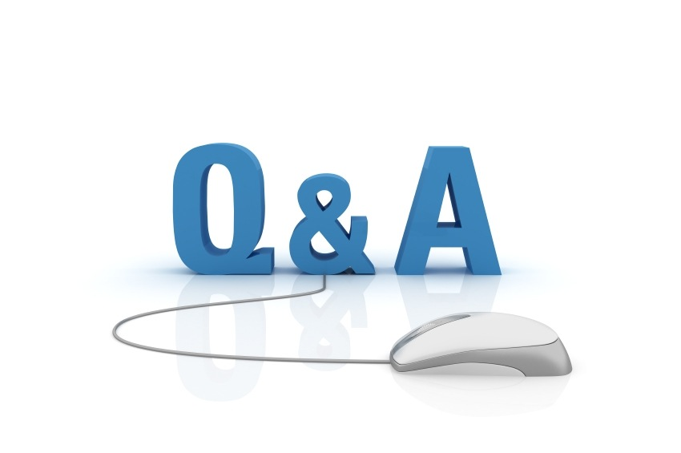
13

Slide 15


